Slide 1
JOURNAL REVIEW
HEART FAILURE MANAGEMENT – BETA BLOCKERS
DR HIMAL RAJ M
SR CARDIOLOGY

Slide 2
INTRODUCTION
βblockers traditionally considered contraindicated in patients with heart failure
substantial reduction in mortality (∼30%) and morbidity
improvement in symptoms and patient’s well-being

Slide 3
QUESTIONS
Are beta blockers beneficial in heart failure?
Which beta blockers are beneficial in heart failure?
Among the beta blockers, which is most effective?
Are beta blockers beneficial across all classes of heart failure?

Slide 4
QUESTIONS
Are beta blockers beneficial in ischemic as well as non ischemic heart failure?
Are beta blockers beneficial in heart failure with preserved ejection fraction?
Should beta blockers be discontinued in acute decompensated heart failure?

Slide 5

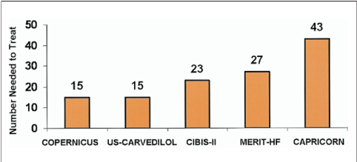
Treatment of 15 to 43 patients with heart failure prevents 1 death
Mortality benefit in the overall cohort
Bangalore etal JACC Vol. 50, No. 7, 2007

Slide 6
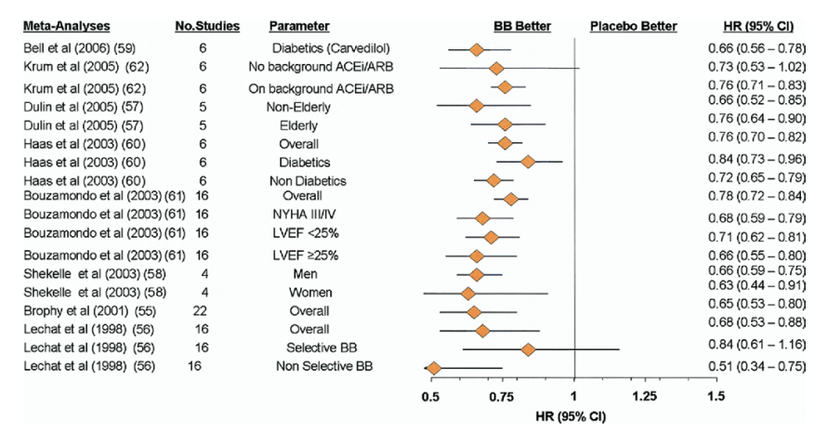
Bangalore etal JACC Vol. 50, No. 7, 2007

Slide 7
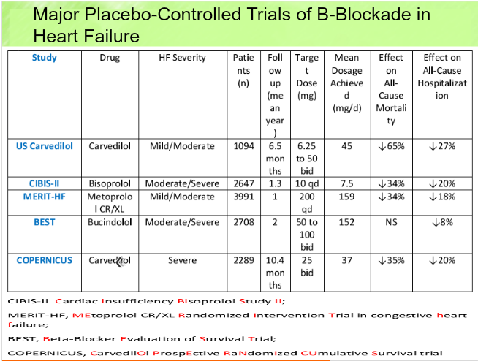

Slide 8
Which BB are beneficial in HF
3 BB- Bisoprolol, Carvedilol and Metoprolol succinate -conclusively shown to reduce mortality and morbidity in patients with systolic heart failure
Not all beta-blockers equally effective in heart failure –Bucindolol and nebivolol
Atenolol – absence of RCTs

Slide 9
BETA BLOCKERS AND IMPORTANT TRIALS
CARVEDILOL – US CARVEDILOL STUDY, COPERNICUS,CAPRICORN
BISOPROLOL - CIBIS II
METOPROLOL – MERIT HF
BUCINDOLOL – BEST
NEBIVOLOL - SENIORS

Slide 10

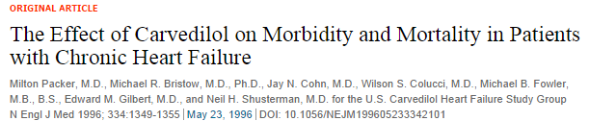
1094 patients
Symptoms of heart failure for atleast 3 months and EF≤ 0.35, despite 2 months of treatment with diuretics and an ACEI
Carvedilol – 6.25 mg bd gradually increased to max of 50 mg bd
Avg follow up – 6.5 months

Slide 11
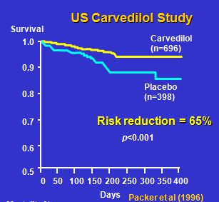
Reduction in risk attributable to carvedilol was 65 percent (95 percent CI, 39 to 80 percent; P<0.001)

Slide 12

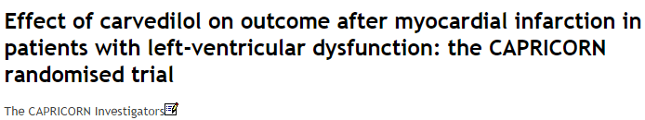
1959 patients
Proven acute myocardial infarction and EF ≤40%
6·25 mg carvedilol progressively increased to a maximum of 25 mg bd.
Avg follow up – 15 months
All-cause mortality alone was lower in the carvedilol group than in the placebo group (116 [12%] vs 151 [15%]

Slide 13
All-Cause Mortality
CAPRICORN
1.0
0·77 [0·60—0·98], p=0·03).
0.9
Carvedilol
Proportion Event Free
Placebo
0.8
P=0.031
0.7
0
0.5
1.0
1.5
2.0
2.5
Years
The CAPRICORN Investigators, Lancet 2001

Slide 14
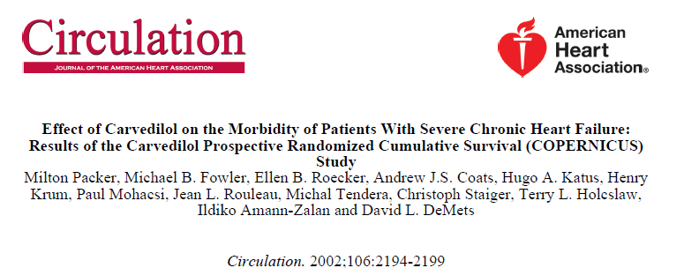
2289 patients
symptoms of heart failure at rest or on minimal exertion and with an EF < 25%

Slide 15
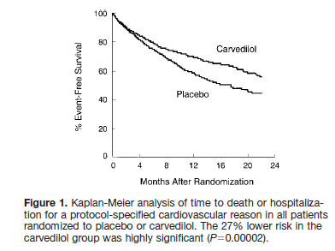
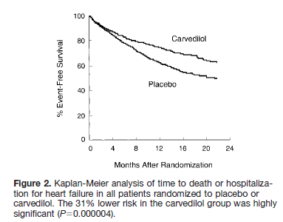
Avg follow up - 10.4 months
carvedilol 3.125 mg bd to 25 mg bd significantly reduced total death (HR 0.65, 0.52-0.81, p=0.0014)

Slide 16
COPERNICUS
All-cause mortality
100
90
80
Carvedilol
% Survival
70
Placebo
p=0.00013
35% risk reduction
60
0
0
3
6
9
12
15
18
21
Months
Packer, AHA 2000
Notes:
Kaplan-Meier curve displaying all-cause mortality in the placebo and carvedilol groups in the COPERNICUS trial.
Highly significant risk reduction of 35% in patients treated with carvedilol compared to placebo.
Separation of mortality curves already seen from 3-4 months.

Slide 17


2647 patients
NYHA class III or IV with EF ≤35% receiving standard therapy with diuretics and ACEIs
Bisoprolol 1·25 mg daily progressively increased to max 10 mg per day.
Avg follow up - 1·3 yrs

Slide 18
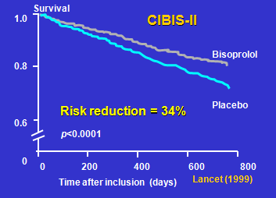

Slide 19
All-cause mortality significantly lower with bisoprolol than on placebo
156 [11·8%] vs 228 [17·3%] deaths with a hazard ratio of 0·66 (95% CI 0·54—0·81, p<0·0001

Slide 20

3991 patients
EF <0.40 and NYHA class II-IV heart failure, stabilized by optimum standard therapy
metoprolol 12.5 (NYHA III-IV) or 25 mg (NYHA II) od, increasing to max target dose 200 mg od
Avg follow up – 1 year

Slide 21
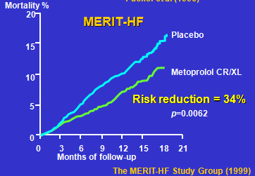
    All-cause mortality significantly lower in metoprolol CR/XL group (145 vs. 217, 34% risk reduction, P=0.0062)

Slide 22

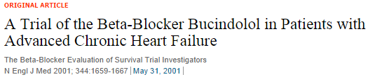
2708 patients
NYHAclass III or IV and EF ≤ 35 percent
Avg follow up – 2 yrs
no significant difference in mortality between the two groups (unadjusted P=0.16).
(HR 0.90, 0.78-1.02, p=0.10)
no significant overall survival benefit.

Slide 23
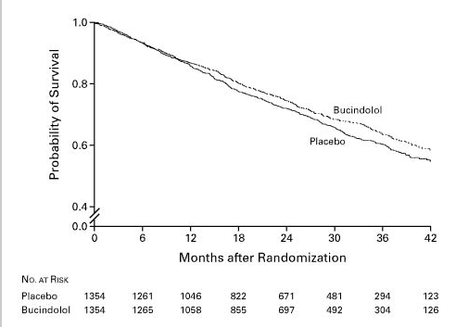
Survival According to Treatment Group

Slide 24

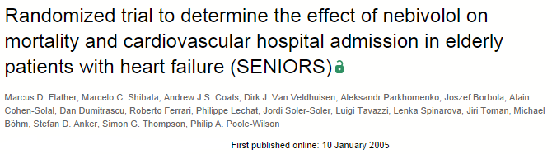
2128 patients
Age ≥70 years with a history of heart failure (hospital admission for heart failure within the previous year or known EF ≤35%)
Initial dose - 1.25 mg od - increased - target of 10 mg od
Avg follow-up - 21 months

Slide 25
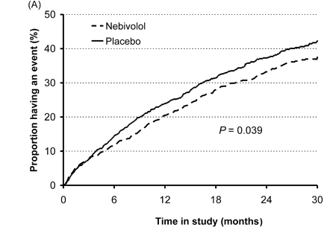
Nebivolol reduced the composite end point of all-cause mortality and cardiovascular hospitalization (HR=0.86; 95% CI, 0.74-0.99; P=.039) but did not reduce the total mortality rate

Slide 27
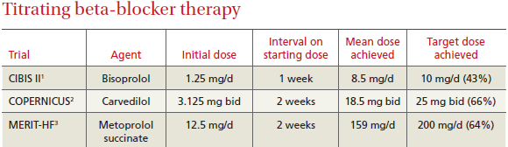

Slide 28
Among the BB,which is most effective
Carvedilol and metoprolol - similar hemodynamics and heart rate effects
COMET trial - carvedilol is superior in extending survival

Slide 29

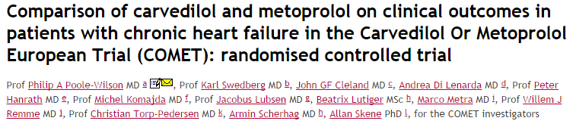
3029 patients
Patients with chronic heart failure (NYHA II–IV), previous admission for a cardiovascular reason, an EF < 0·35 and to have been treated optimally with diuretics and ACEIs
treatment with carvedilol (target dose 25 mg bd) and metoprolol (metoprolol tartrate, target dose 50 mg bd)

Slide 30
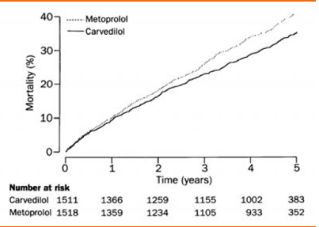
Mean study duration was 58 months
The all-cause mortality was 34% for carvedilol and 40% for metoprolol (hazard ratio 0·83 [95% CI 0·74–0·93], p=0·0017)
Results suggested that carvedilol extends survival compared with metoprolol.

Slide 31
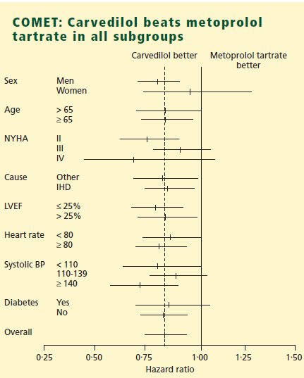

Slide 32
Are BB beneficial across all classes of HF
Beta blockers are found to be effective across all classes of heart failure

Slide 33
β blockers in NYHA class IV heart failure
Proportion of patients
with class IV heart failure
US Carvedilol Programme 3%
MERIT-HF 4%
CIBIS-II 17%
BEST 8%
Notes:
This need is further enhanced by the fact that very few patients with severe heart failure were randomised in the landmark studies of β blockade in heart failure conducted to date.
Hence, prior to the COPERNICUS trial, there were few data on a potential benefit of adrenergic blockade in patients with severe heart failure.

Slide 34
Class I
Class II
Class III
Class IV
CAPRICORN
(carvedilol)
COPERNICUS
(carvedilol)
US Carvedilol (carvedilol)
CIBIS II (bisoprolol)
MERIT-HF (metoprolol)
Packer, AHA 2000
Notes:
Carvedilol is also currently undergoing study in NYHA class I heart failure patients in the CAPRICORN trial.
With the completion of this trial, carvedilol will be the only β blocker to have been studied in all the stages of the heart failure spectrum.

Slide 35
Survival effects of β blockers in class IV heart failure
MERIT-HF
CIBIS II
BEST
0.25
0.5
0.75
1.0
1.5
2.0
Favours treatment
Favours placebo
Packer, AHA 2000
Notes:
In addition, the little data that were available on the use of β blockers in class IV patients showed inconclusive and inconsistent effects. [Shown are the effects of metoprolol (in MERIT-HF), bisoprolol (in CIBIS-II) and bucindolol (in BEST) in the class IV patients enrolled in these studies.]

Slide 36
Effects of metoprolol in class IV heart failure
Results of MERIT-HF
Death or CHF
hospitalisation
Death or any
hospitalisation
0.25
0.5
0.75
1.0
1.5
2.0
Favours treatment
Favours placebo
Packer, AHA 2000
Notes:
Results from some subgroup analyses also showed improvements, however these were not significant.

Slide 37
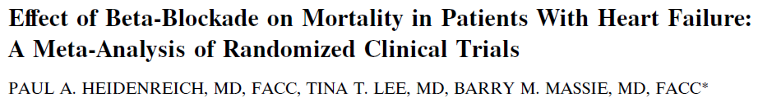

Are BB beneficial in ischemic as well as non ischemic HF
Separate data available for ischemic cardiomyopathy in seven trials including 1,387 patients and for nonischemic cardiomyopathy in nine trials including 1,436 patients
no significant differences in the summary OR between the two groups: ischemic OR 0.69 (95% CI 0.49 to 0.98), nonischemic OR 0.69 (95% CI 0.47 to 0.99)

Slide 38
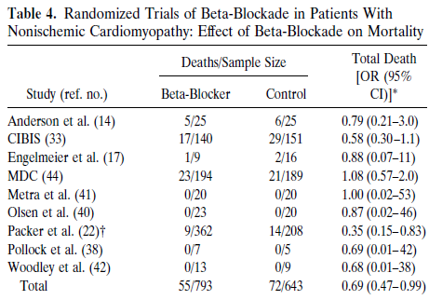
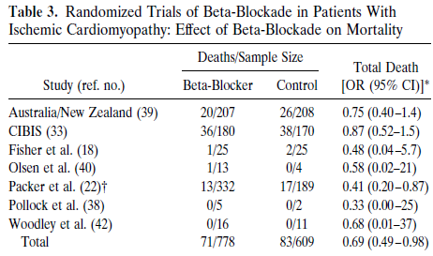

Slide 39
Are BB beneficial in HF with preserved
EF
Betablockers are beneficial in HF with preserved EF

Slide 40
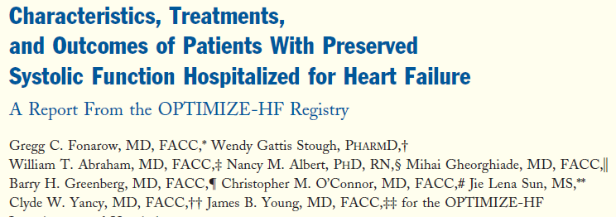
JACCVol. 50, No. 8, 2007
compared 20,118 patients with left ventricular systolic dysfunction (LVSD) and 21,149 patients with PSF (left ventricular ejection fraction [EF] 40%).
there were no significant relationships between discharge use of ACEI/ARB or beta-blocker and 60- to 90-day mortality and rehospitalization rates in patients with PSF.

Slide 41
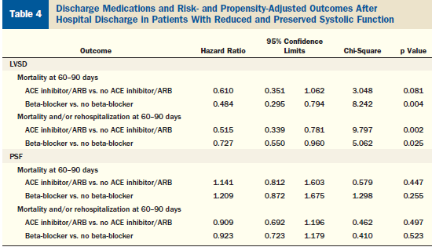

Slide 42
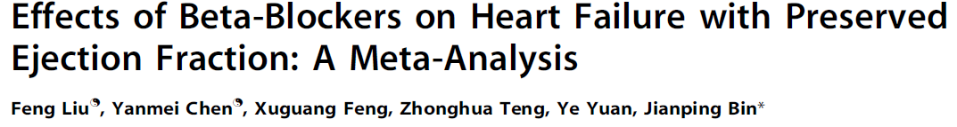

12 clinical studies
21,206 paients with HFpEF
9% reduction in relative risk for all-cause mortality in patients with HFpEF (95% CI: 0.87 – 0.95; P , 0.001)
all-cause hospitalization, HF hospitalization and composite outcomes (mortality and hospitalization) were not affected by this treatment (P = 0.26, P = 0.97, and P = 0.88 respectively)

Slide 43
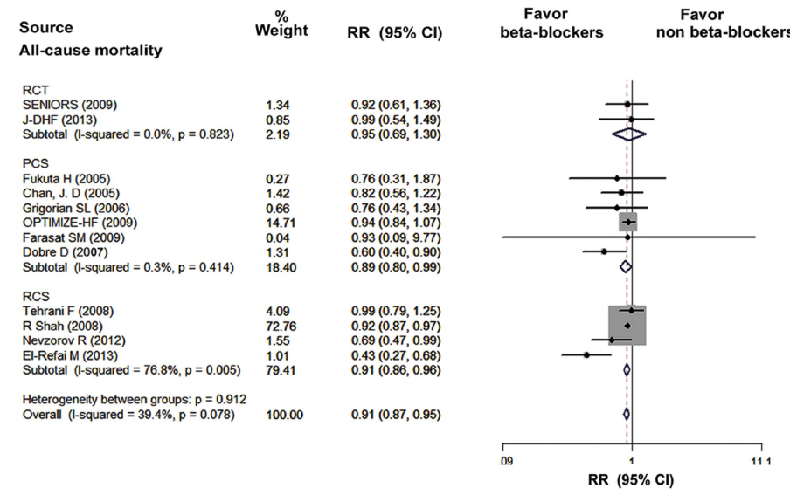

Slide 44
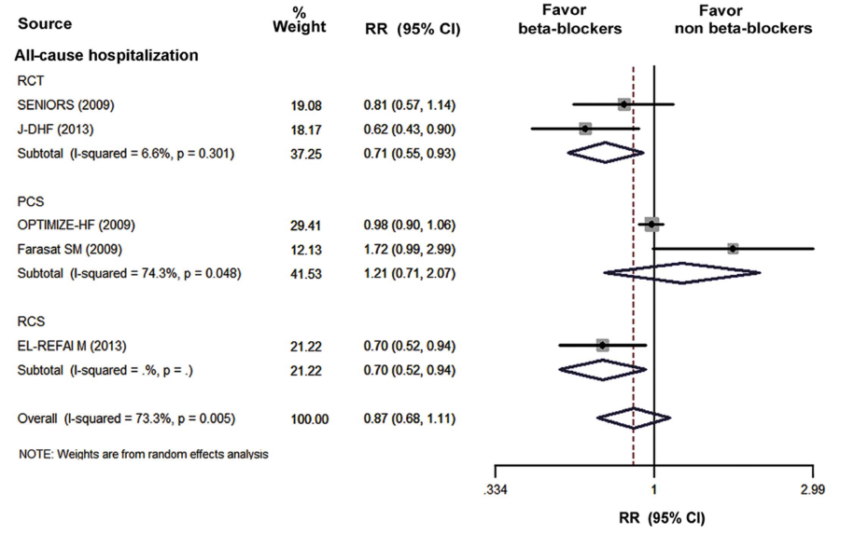

Slide 45
Should BB be discontinued in acute decompensated HF
Beta blockers should not be discontinued in decompensated heart failure

Slide 46

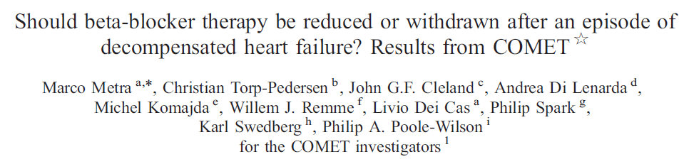
In COMET, 752/3029 patients (25%, 361 carvedilol and 391 metoprolol) had a non-fatal HF hospitalisation while on study treatment.
Of these, 61 patients (8%) had beta-blocker treatment withdrawn, 162 (22%) had a dose reduction and 529 (70%) were maintained on the same dose.

Slide 47
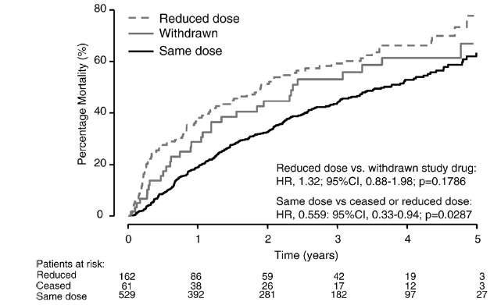
One-and two-year cumulative mortality rates were 28.7% and 44.6% for patients withdrawn from study medication, 37.4% and 51.4% for those with a reduced dosage (n.s.) and 19.1% and 32.5% for those maintained on the same dose
(HR,1.59; 95%CI, 1.28–1.98; P<0.001, compared to the others)

Slide 48

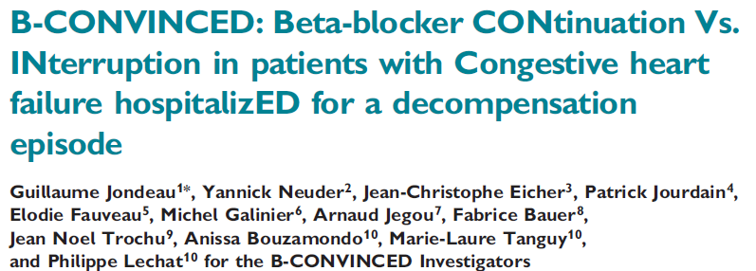
compared beta-blockade continuation vs. discontinuation during ADHF in patients with LVEF below 40% previously receiving stable beta-blocker therapy.
169 patients
After 3 days, 92.8%of patients pursuing beta-blockade improved for both dyspnoea and general well-being according to a physician blinded for therapy vs. 92.3% of patients stopping beta-blocker

Slide 49
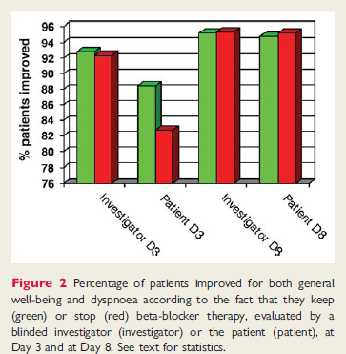
In conclusion, during ADHF, continuation of beta-blocker therapy is not associated with delayed or lesser improvement,
but with a higher rate of chronic prescription of beta-blocker therapy after 3 months, the benefit of which is well established

Slide 50
ACCF/AHA 2013 GUIDELINES

Slide 51
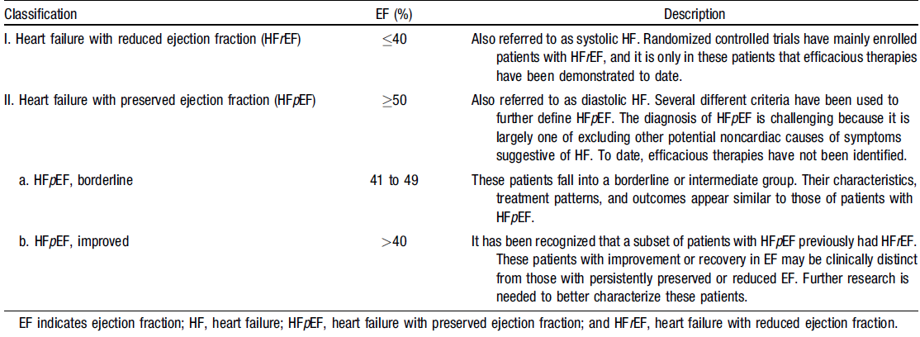
Definitions of HFrEF and HFpEF

Slide 52
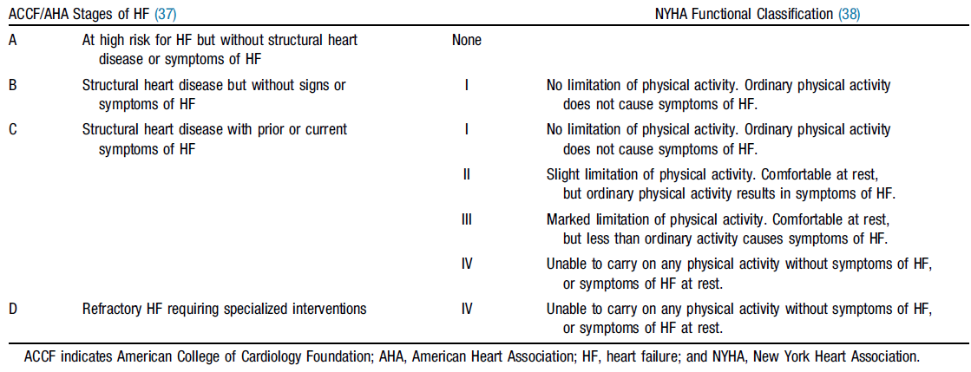

Comparison of ACCF/AHA Stages of HF and NYHA Functional Classifications

Slide 53
Recommendations for Treatment of Stage B HF

Slide 54
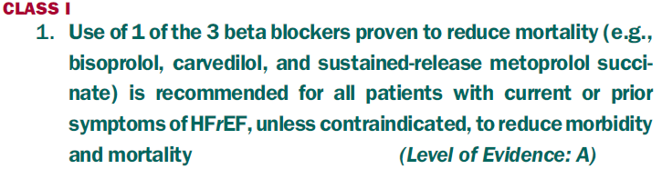
Recommendations for Treatment of Stage C HFrEF

Slide 55
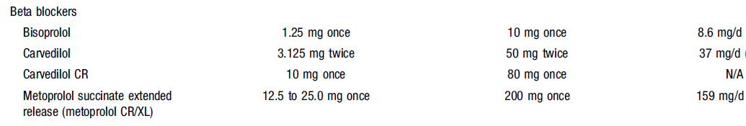

Slide 56
Recommendations for Treatment of HFpEF

Slide 57
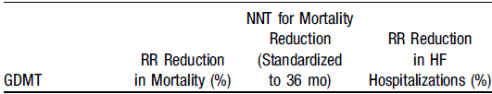
Medical Therapy for Stage C HFrEF:
Magnitude of Benefit Demonstrated in RCTs

Slide 58
Recommendations for Therapies in the Hospitalized HF Patient

Slide 59
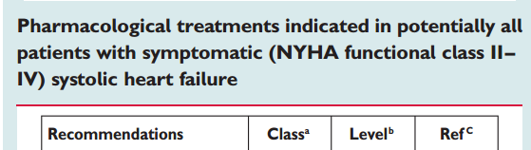
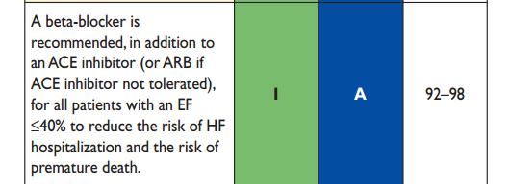
ESC 2012 GUIDELINES

Slide 60
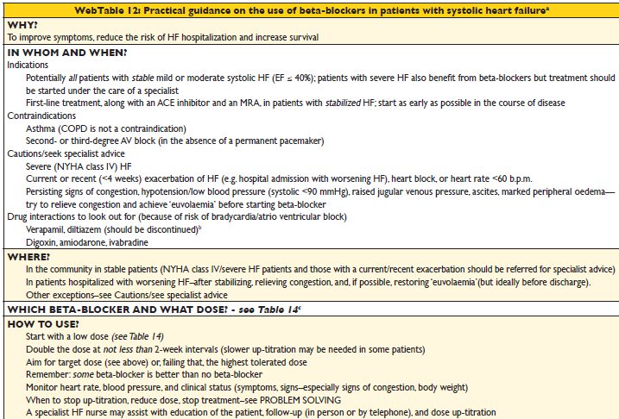

Slide 61
TAKE HOME MESSAGE
Beta blockers are clinically effective in both systolic and diastolic heart failure
Some beta blocker is better than no beta blocker

Slide 62
THANK YOU

